Slide 1

Comprehensive HR Data Analysis for Informed Decision-Making
Presented By: ASHOKRAJ D

Slide 2

Abstract
Utilizing advanced machine learning algorithms, HR data science can develop predictive models to identify employees at a higher risk of attrition. By analyzing historical data on employee turnover, key factors contributing to attrition, such as job satisfaction, performance metrics, and engagement levels, can be identified. This empowers HR professionals to proactively address potential attrition risks and implement targeted retention strategies.
Focused on attendance data, the analysis aims to meet stakeholders' expectations by exploring working preferences, enhancing capacity planning, identifying health-related patterns, and understanding correlations with external factors.
The project's key objectives include assessing the frequency and reasons for remote work, evaluating overall employee presence for effective capacity planning, scrutinizing sick leave patterns to identify potential health concerns, and examining the impact of external events on attendance.
Through a comprehensive analytics report, the project aims to empower HR and organizational leaders with valuable insights to make informed decisions related to team building, space utilization, and health measures. .

Slide 3
Existing System
Manual data collection: Gathering information through paper forms, emails, or spreadsheets.
Limited data analysis: Utilizing basic spreadsheet functions or relying on intuition for decision-making.
Limited insights: Difficulty in identifying trends, patterns, or root causes of issues like high turnover or low productivity.
Reactive approach: Responding to problems only after they arise, causing delays and potential financial losses

Slide 4




Proposed System
Advanced data analysis: Employing tools like statistical analysis, machine learning, and data visualization.​
Proactive approach: Leveraging insights to improve hiring, training, compensation, and overall employee experience.
Actionable insights: Identifying key factors influencing employee performance, engagement, and retention.​
Predictive modeling: Proactively identifying potential issues and developing data-driven solutions.​

Slide 5
Random Forest Algorithm
Random Forest is a popular machine learning algorithm used for both classification and regression tasks in data analysis. It belongs to the ensemble learning methods, which combine multiple models to improve predictive performance.
It takes less training time as compared to other algorithms.
It predicts output with high accuracy, even for the large dataset it runs efficiently.
It can also maintain accuracy when a large proportion of data is missing.
Implementation Steps of Random Tree Forest Algorithum:
Data Pre-processing step
Fitting the Random forest algorithm to the Training set
Predicting the test result
Test accuracy of the result (Creation of Confusion matrix)
Visualizing the test set result.

Slide 6
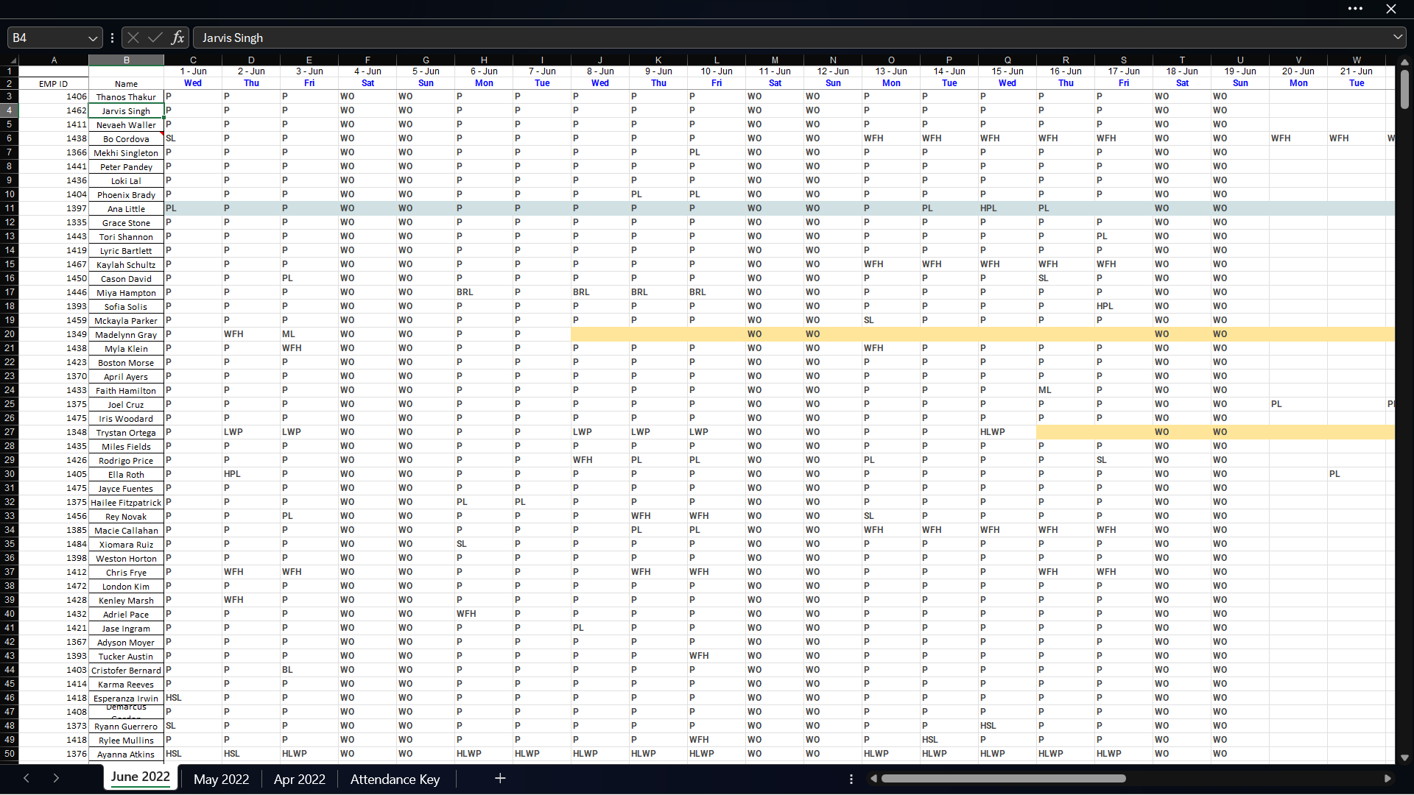
Unprocessed Data:

Slide 7
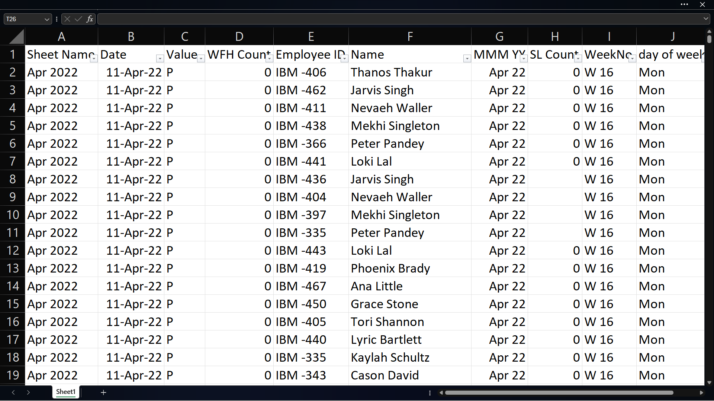
Processed Data:

Slide 8
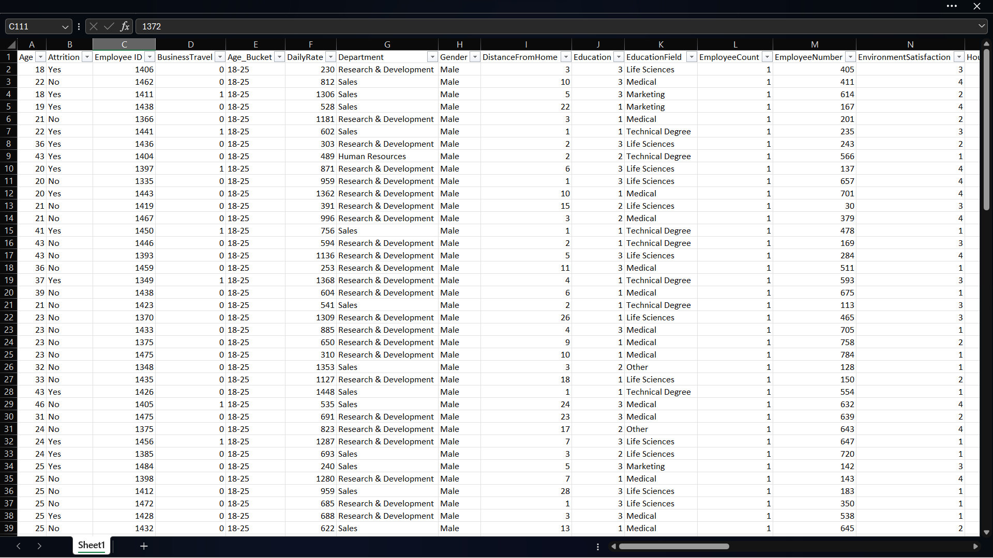
Processed Data:

Slide 9
Life Cycle Of HR Analysis
Question Formulation
Data Acquisition
Data Management
Data Analysis
Data Interpretation and Storytelling
Deployment and Implementation

Slide 10

Conclusion
In summary, the HR data analysis project has provided valuable insights into attendance, remote work preferences, and health-related patterns, enhancing capacity planning and suggesting a potential shift towards a hybrid work model.
By examining various factors such as work environment, leadership, career development opportunities, and compensation, HR can gain valuable insights into the specific issues influencing attrition.

Slide 11

THANK YOU

